Slide 1

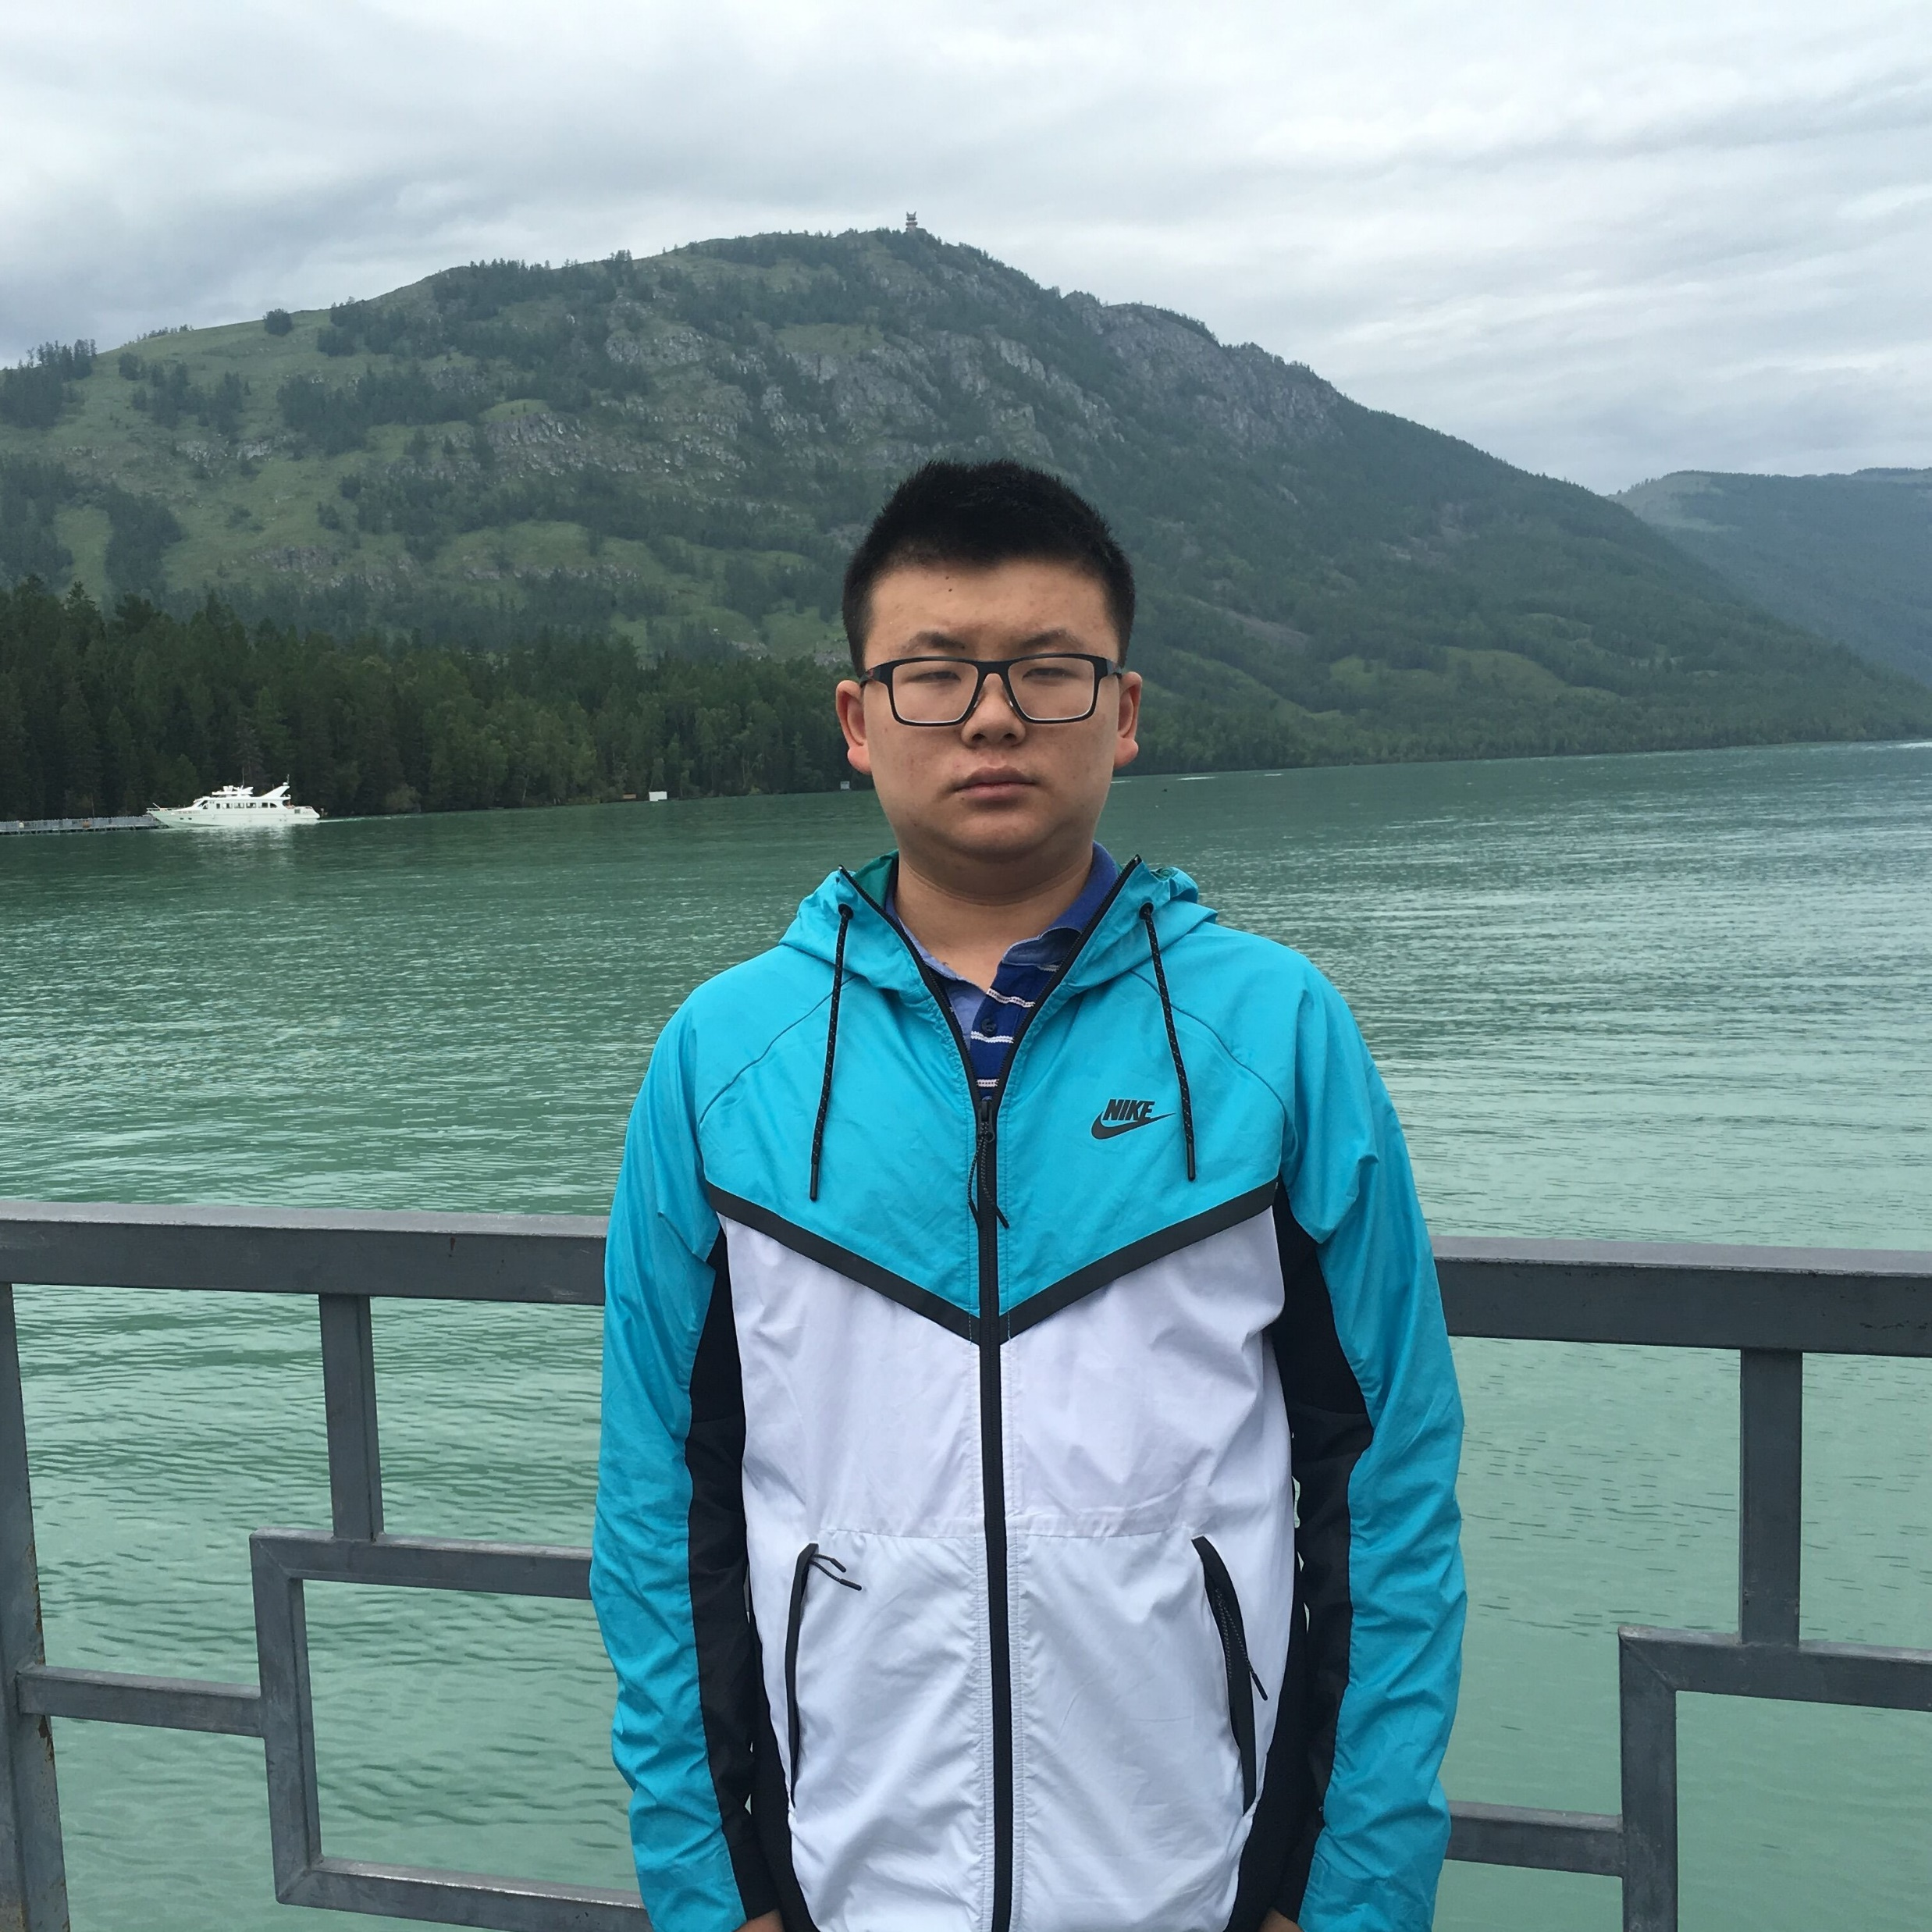



A Strong Separation for Adversarially Robust $ℓ_{0}$ Estimation for Linear Sketches
Elena Gribelyuk
Honghao Lin
David P. Woodruff
Huacheng Yu
Samson Zhou

Slide 2
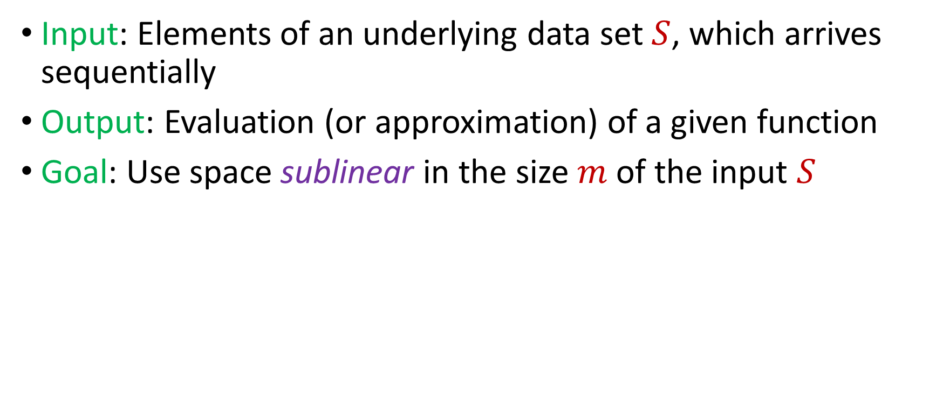
Streaming Model
Input: Elements of an underlying data set $S$, which arrives sequentially
Output: Evaluation (or approximation) of a given function
Goal: Use space sublinear in the size $m$of the input $S$

Slide 3
Lots of problems…
Graph problems: Matchings, MST, MAX-CUT
Geometric problems: Clustering, facility location
Statistical problems: Heavy-hitters, norm/moment estimation, quantile estimation
Algebraic problems: Subspace embeddings, regression, low-rank approximation
String problems: pattern matching, periodicity
Others: CSPs, coding theory, submodular optimization, etc

Slide 4
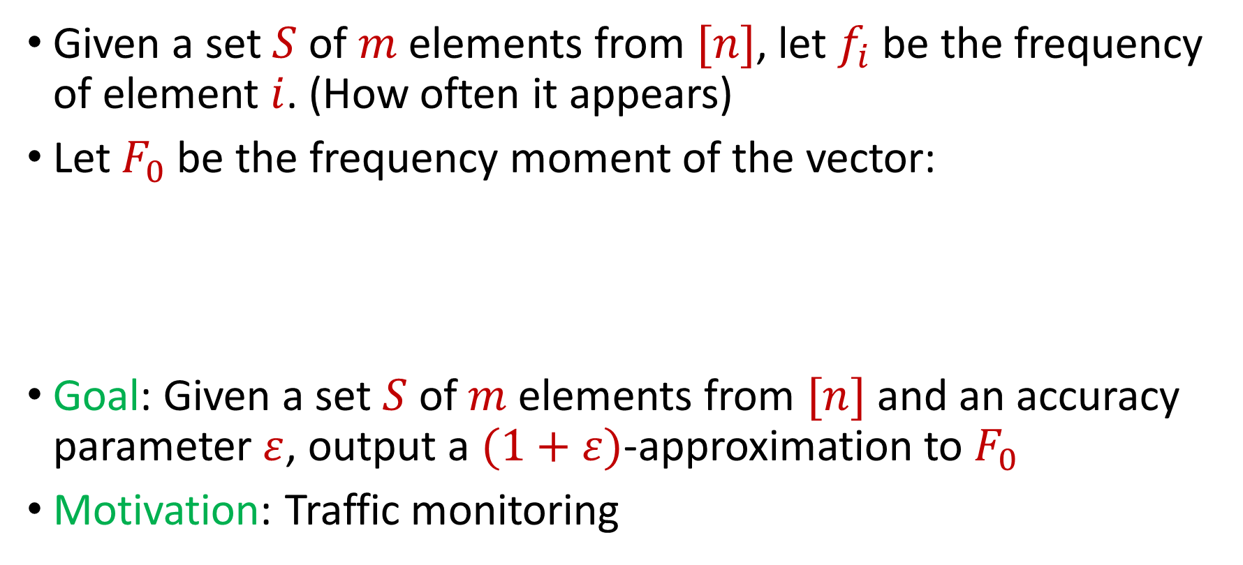
Distinct Elements
Given a set $S$ of $m$ elements from $[n]$, let $f_{i}$ be the frequency of element $i$. (How often it appears)
Let $F_{0}$ be the frequency moment of the vector:
Goal: Given a set $S$ of $m$ elements from $[n]$ and an accuracy parameter $ε$, output a $(1+ε)$-approximation to $F_{0}$
Motivation: Traffic monitoring
$F_{0}=$ $|\{i :f_{i}≠0\}|$

Slide 5
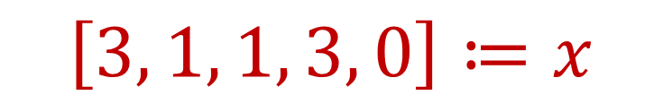
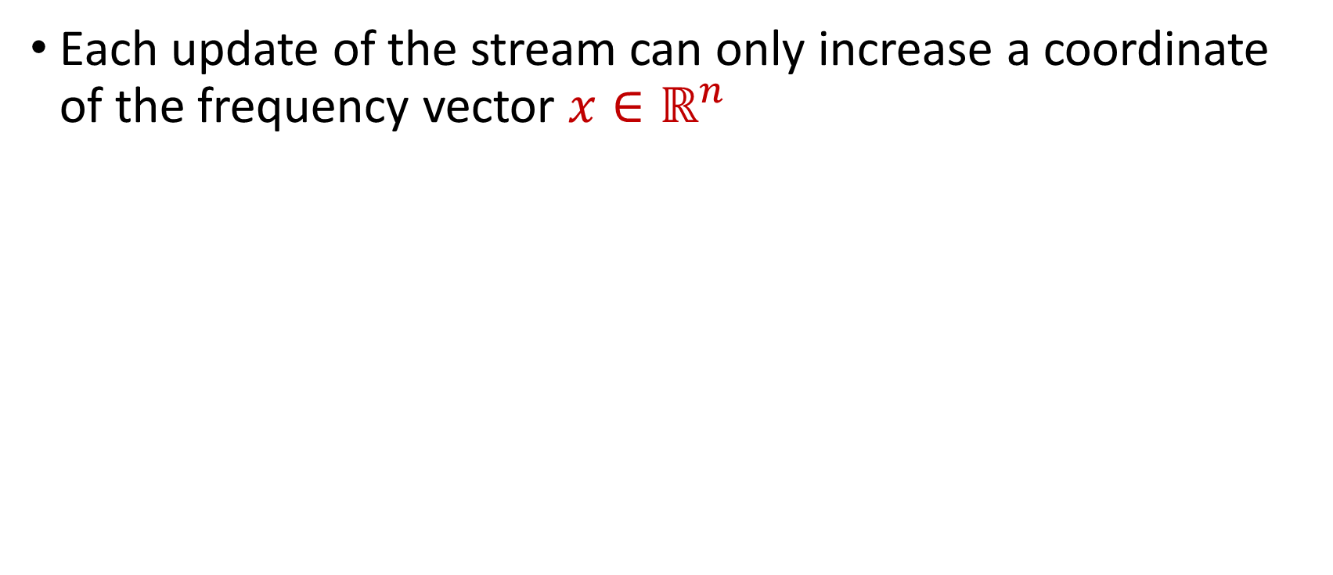
Insertion-Only Streams
Each update of the stream can only increase a coordinate of the frequency vector $x∈ℝ^{n}$
1 4 2 1 3 4 4 1 
$$\left[3, 1, 1, 3, 0\right]≔x$$
4 Distinct Elements

Slide 6

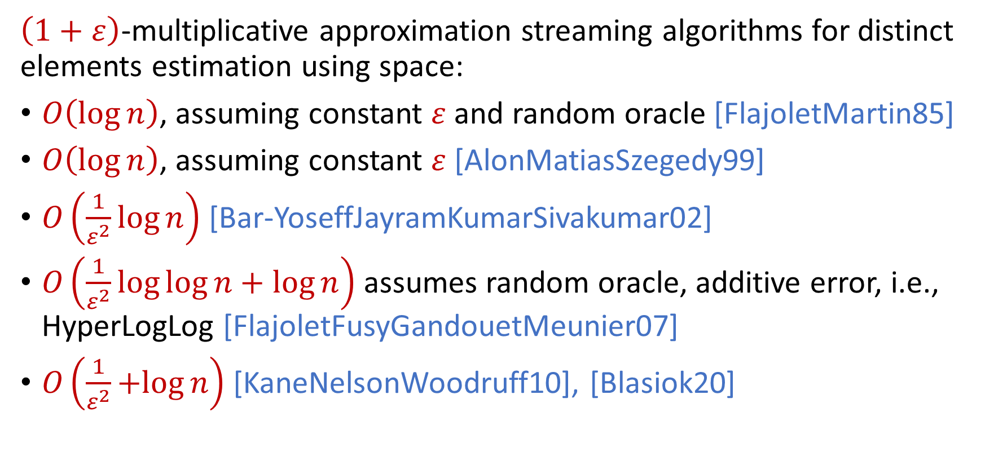
Streaming Algorithms for $ℓ_{0}$ Estimation
$\left(1+ε\right)$-multiplicative approximation streaming algorithms for distinct elements estimation using space:
$O\left(\log{n}\right)$, assuming constant $ε$ and random oracle [FlajoletMartin85]
$O\left(\log{n}\right)$, assuming constant $ε$ [AlonMatiasSzegedy99]
$O\left(\frac{1}{ε^{2}}\log{n}\right)$ [Bar-YoseffJayramKumarSivakumar02]
$O\left(\frac{1}{ε^{2}}\log{\log{n}}+\log{n}\right)$ assumes random oracle, additive error, i.e., HyperLogLog [FlajoletFusyGandouetMeunier07]
$O\left(\frac{1}{ε^{2}}+log{n}\right)$ [KaneNelsonWoodruff10], [Blasiok20]

Slide 7
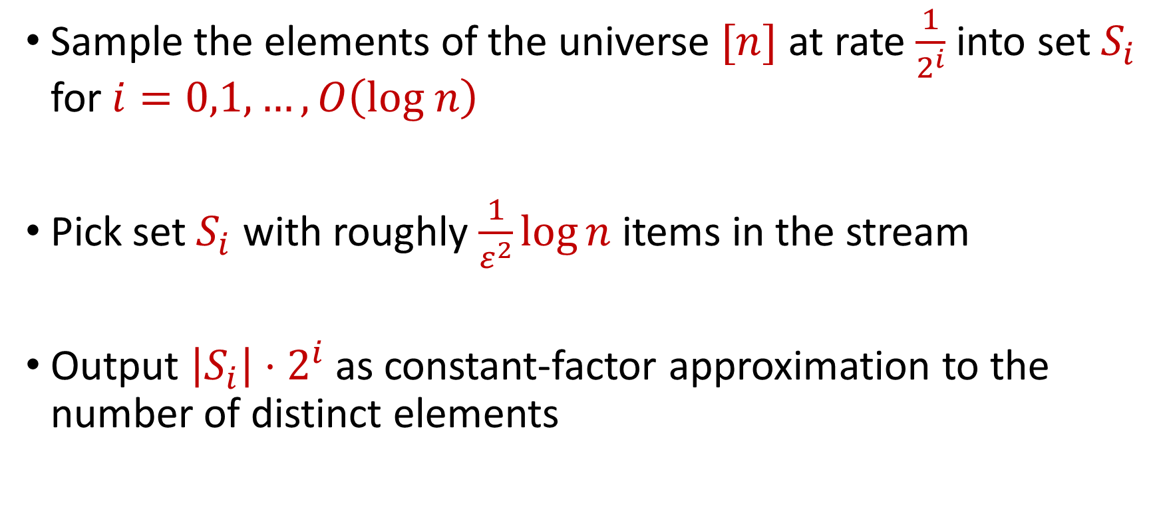
Streaming Algorithms for $ℓ_{0}$ Estimation
Sample the elements of the universe $[n]$ at rate $\frac{1}{2^{i}}$ into set $S_{i}$ for $i=0,1,…,O\left(log n\right)$
Pick set $S_{i}$ with roughly $\frac{1}{ε^{2}}\log{n}$ items in the stream
Output $\left|S_{i}\right|⋅2^{i}$ as constant-factor approximation to the number of distinct elements

Slide 8


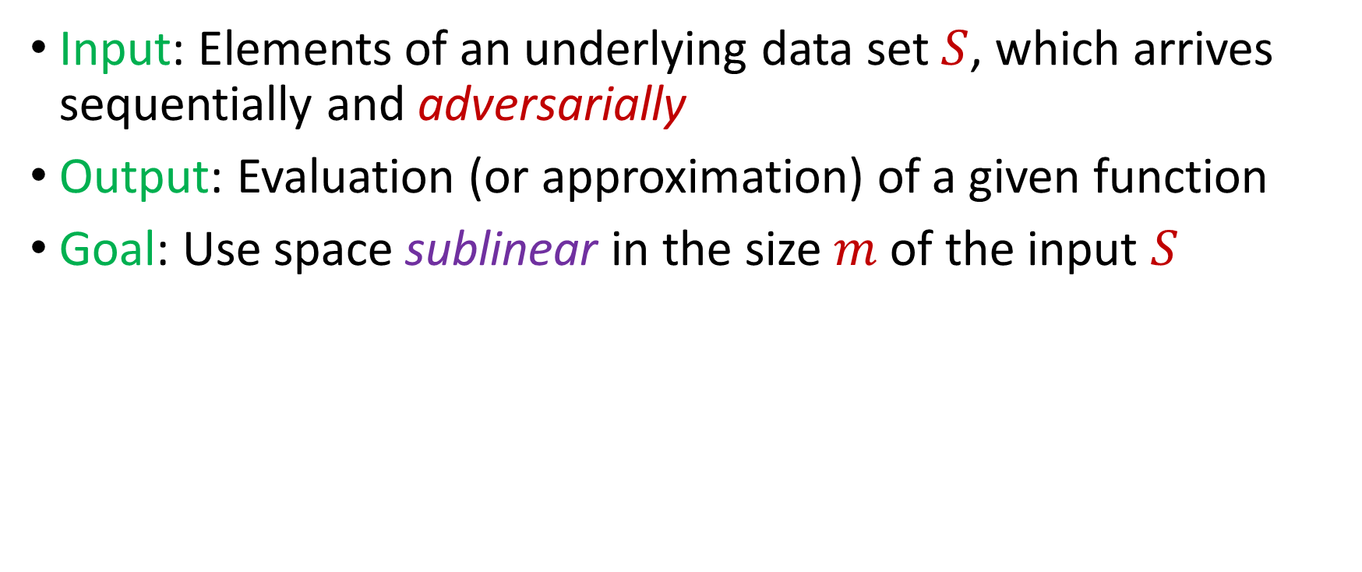
Adversarially Robust Streaming
Input: Elements of an underlying data set $S$, which arrives sequentially and adversarially
Output: Evaluation (or approximation) of a given function
Goal: Use space sublinear in the size $m$of the input $S$
1
1

Slide 9
Adversarially Robust Streaming
Input: Elements of an underlying data set $S$, which arrives sequentially and adversarially
Output: Evaluation (or approximation) of a given function
Goal: Use space sublinear in the size $m$of the input $S$
1 4
2

Slide 10
Adversarially Robust Streaming
Input: Elements of an underlying data set $S$, which arrives sequentially and adversarially
Output: Evaluation (or approximation) of a given function
Goal: Use space sublinear in the size $m$of the input $S$
1 4 2
3

Slide 11

Adversarially Robust Streaming
Input: Elements of an underlying data set $S$, which arrives sequentially and adversarially
Output: Evaluation (or approximation) of a given function
Goal: Use space sublinear in the size $m$of the input $S$
1 4 2 1
4

Slide 12

Adversarially Robust Streaming
Input: Elements of an underlying data set $S$, which arrives sequentially and adversarially
Output: Evaluation (or approximation) of a given function
Goal: Use space sublinear in the size $m$of the input $S$
1 4 2 1
4

Slide 13
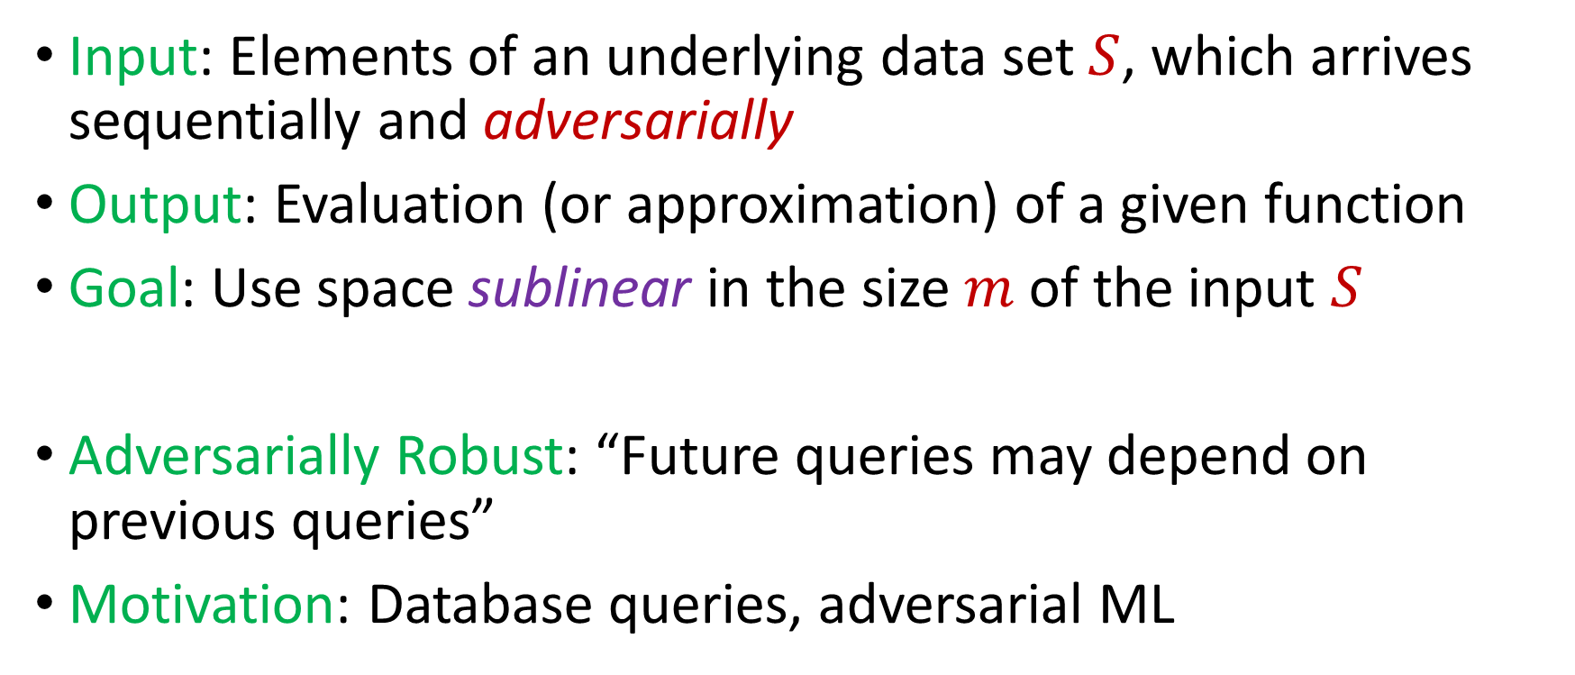
Adversarially Robust Streaming
Input: Elements of an underlying data set $S$, which arrives sequentially and adversarially
Output: Evaluation (or approximation) of a given function
Goal: Use space sublinear in the size $m$of the input $S$
Adversarially Robust: “Future queries may depend on previous queries”
Motivation: Database queries, adversarial ML
Notes:
Let’s start by breaking down each of the terms in the title. To understand the sliding window model, we first have to understand the streaming model of computation, in which elements of an underlying data set S, arrive sequentially and the goal is to evaluate or approximate some given function on this dataset, using space sublinear in S. In the sliding window model, only the W most recent updates form the underlying data set

Slide 14

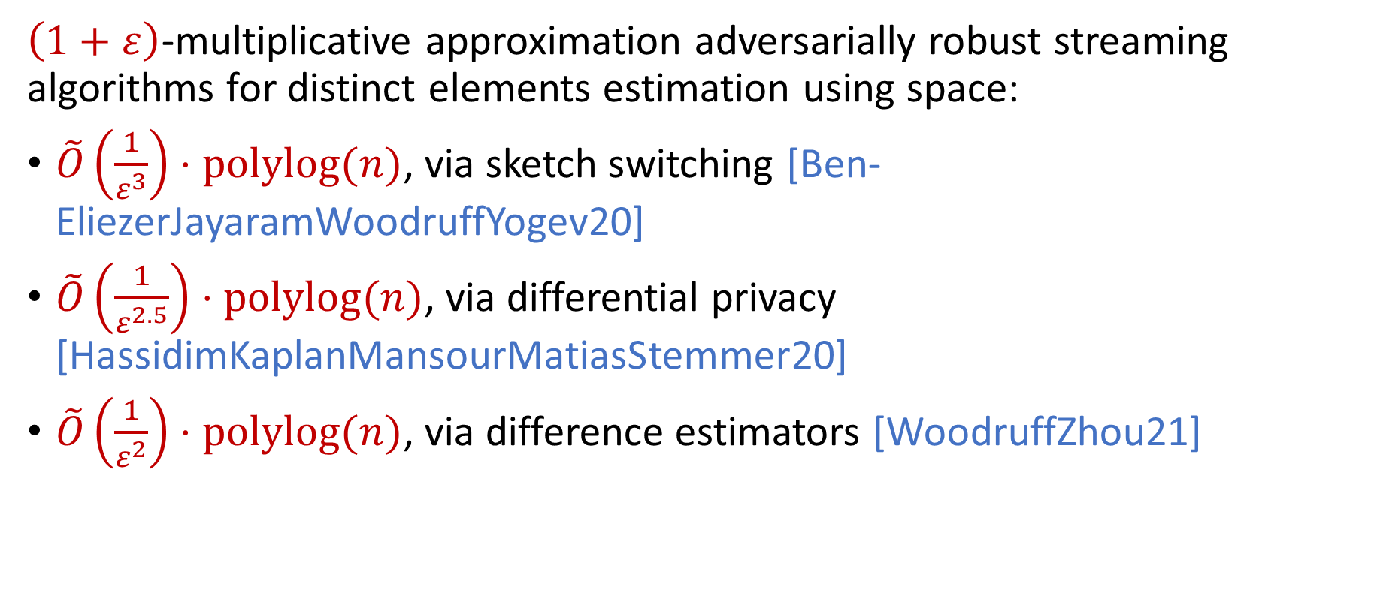
Robust Algorithms for $ℓ_{0}$ Estimation
$\left(1+ε\right)$-multiplicative approximation adversarially robust streaming algorithms for distinct elements estimation using space:
$\tilde{O}\left(\frac{1}{ε^{3}}\right)⋅polylog(n)$, via sketch switching [Ben-EliezerJayaramWoodruffYogev20]
$\tilde{O}\left(\frac{1}{ε^{2.5}}\right)⋅polylog(n)$, via differential privacy [HassidimKaplanMansourMatiasStemmer20]
$\tilde{O}\left(\frac{1}{ε^{2}}\right)⋅polylog(n)$, via difference estimators [WoodruffZhou21]

Slide 15
Robust Algorithms for $ℓ_{0}$ Estimation
$\left(1+ε\right)$-multiplicative approximation adversarially robust streaming algorithms for distinct elements estimation using space:
$\tilde{O}\left(\frac{1}{ε^{3}}\right)⋅polylog(n)$, via sketch switching [Ben-EliezerJayaramWoodruffYogev20]
$\tilde{O}\left(\frac{1}{ε^{2.5}}\right)⋅polylog(n)$, via differential privacy [HassidimKaplanMansourMatiasStemmer20]
$\tilde{O}\left(\frac{1}{ε^{2}}\right)⋅polylog(n)$, via difference estimators [WoodruffZhou21]
Nearly tight results for adversarial robustness on insertion-only streams

Slide 16
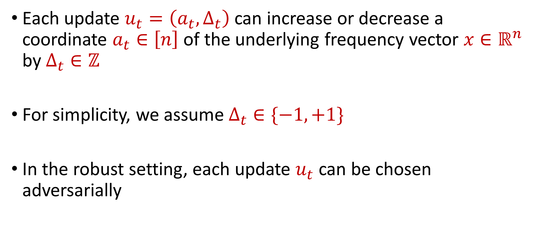
Insertion-Deletion Streams
Each update $u_{t}=\left(a_{t},Δ_{t}\right)$ can increase or decrease a coordinate $a_{t}∈\left[n\right]$ of the underlying frequency vector $x∈ℝ^{n}$ by $Δ_{t}∈ℤ$
For simplicity, we assume $Δ_{t}∈\{−1,+1\}$
In the robust setting, each update $u_{t}$ can be chosen adversarially

Slide 17
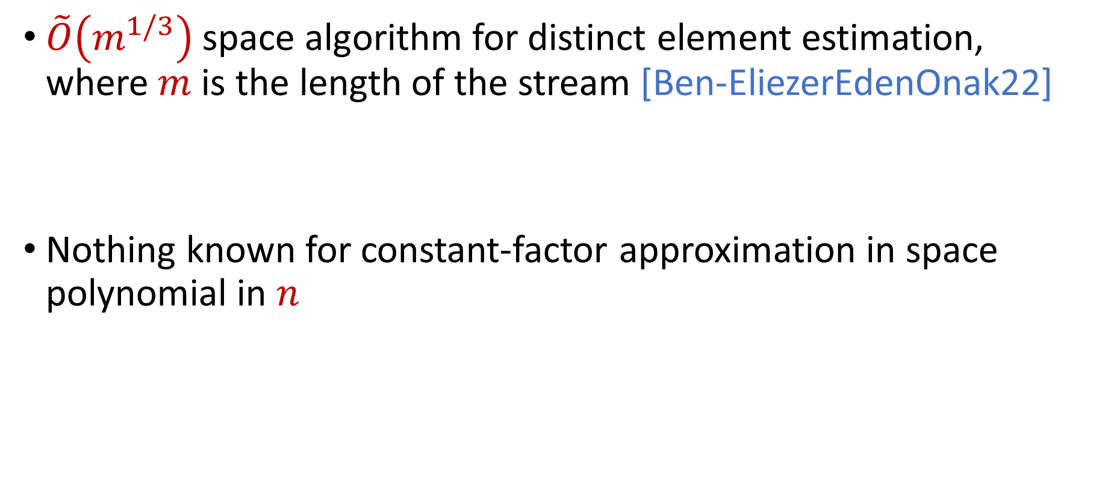
Insertion-Deletion Streams
$\tilde{O}\left(m^{1/3}\right)$ space algorithm for distinct element estimation, where $m$is the length of the stream [Ben-EliezerEdenOnak22]
Nothing known for constant-factor approximation in space polynomial in $n$

Slide 18
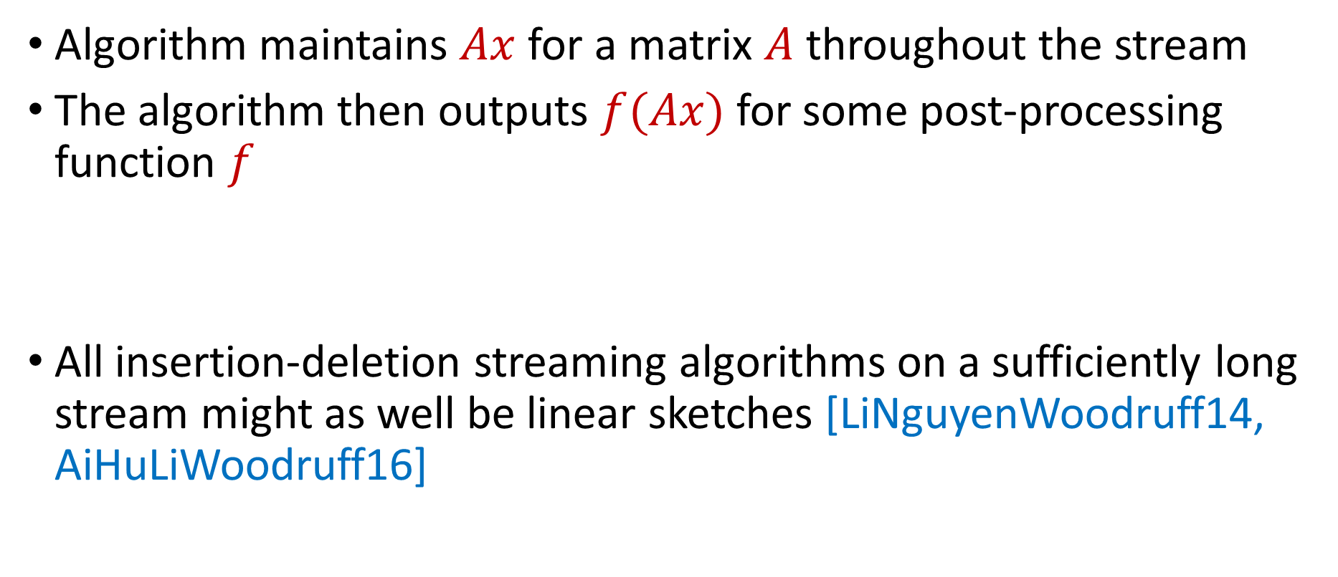
Linear Sketch
Algorithm maintains $Ax$ for a matrix $A$ throughout the stream
The algorithm then outputs $f(Ax)$ for some post-processing function $f$
All insertion-deletion streaming algorithms on a sufficiently long stream might as well be linear sketches [LiNguyenWoodruff14, AiHuLiWoodruff16]

Slide 19
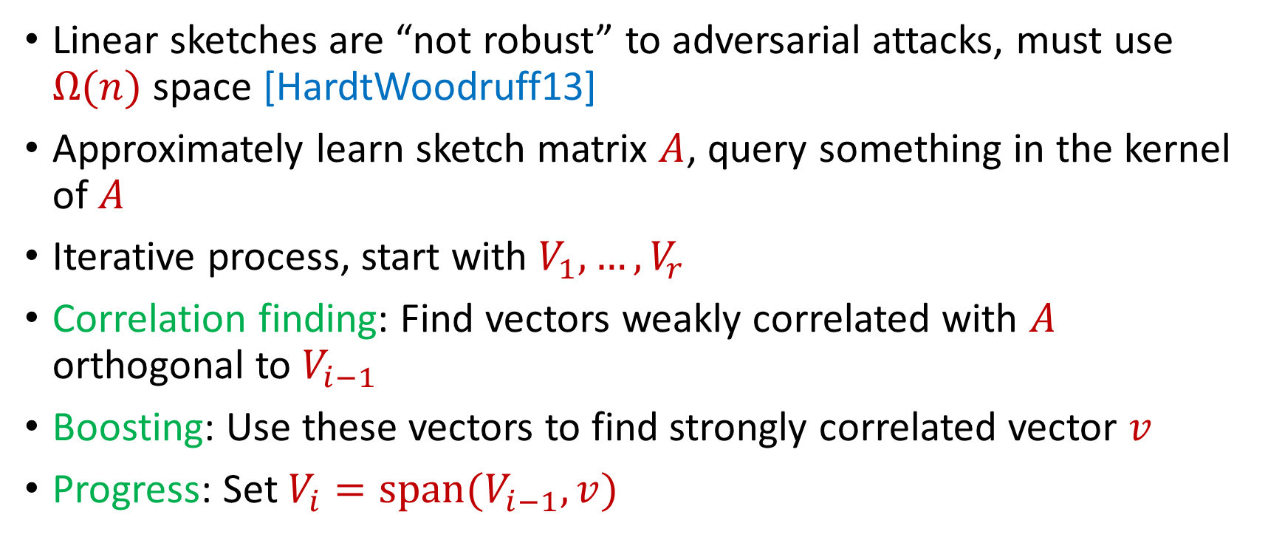
Reconstruction Attack on Linear Sketches
Linear sketches are “not robust” to adversarial attacks, must use $Ω(n)$ space [HardtWoodruff13]
Approximately learn sketch matrix $A$, query something in the kernel of $A$
Iterative process, start with $V_{1},…,V_{r}$
Correlation finding: Find vectors weakly correlated with $A$ orthogonal to $V_{i−1}$
Boosting: Use these vectors to find strongly correlated vector $v$
Progress: Set $V_{i}=span(V_{i−1},v)$

Slide 20
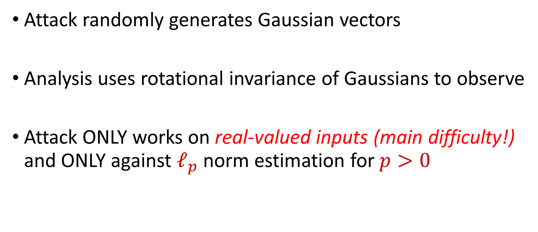
Reconstruction Attack on Linear Sketches
Attack randomly generates Gaussian vectors
Analysis uses rotational invariance of Gaussians to observe
Attack ONLY works on real-valued inputs (main difficulty!) and ONLY against $ℓ_{p}$ norm estimation for $p>0$

Slide 21
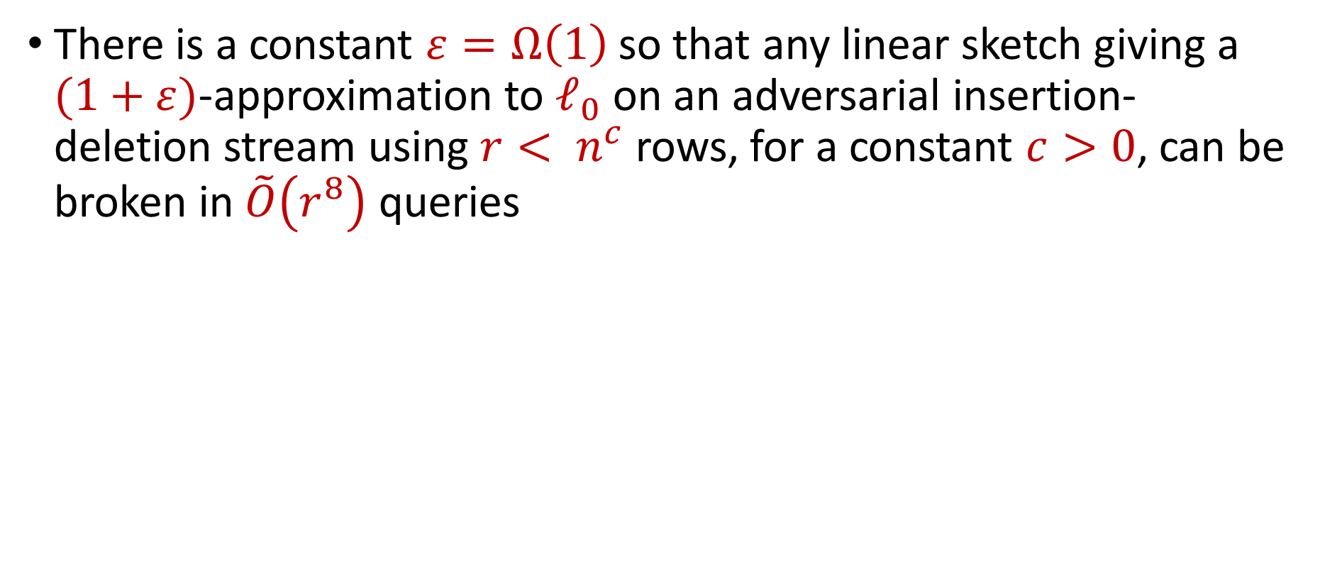
Our Contribution
There is a constant $ε=Ω\left(1\right)$ so that any linear sketch giving a $(1+ε)$-approximation to $ℓ_{0}$ on an adversarial insertion-deletion stream using $r< n^{c}$ rows, for a constant $c>0$, can be broken in $\tilde{O}\left(r^{8}\right)$ queries

Slide 22
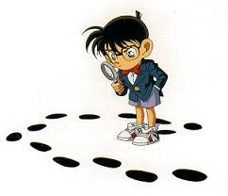
Questions?
Upcoming
Attack intuition

Slide 23

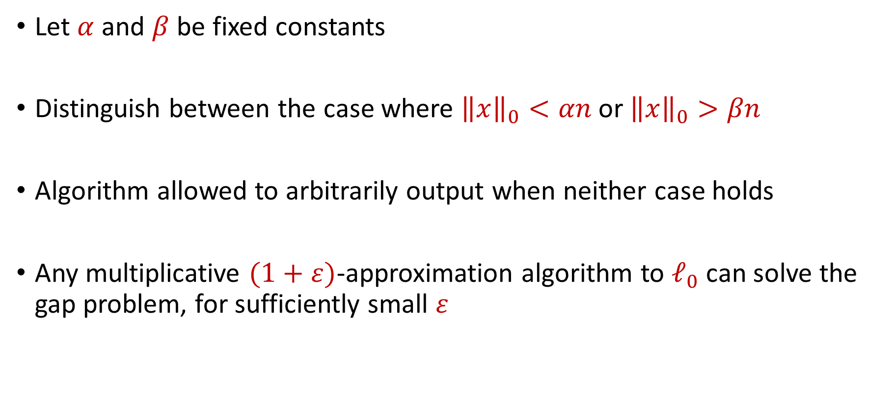
Gap $ℓ_{0}$ Norm Problem
Let $α$ and $β$ be fixed constants
Distinguish between the case where ${\left\|x\right\|}_{0}<αn$ or ${\left\|x\right\|}_{0}>βn$
Algorithm allowed to arbitrarily output when neither case holds
Any multiplicative $(1+ε)$-approximation algorithm to $ℓ_{0}$ can solve the gap problem, for sufficiently small $ε$

Slide 24
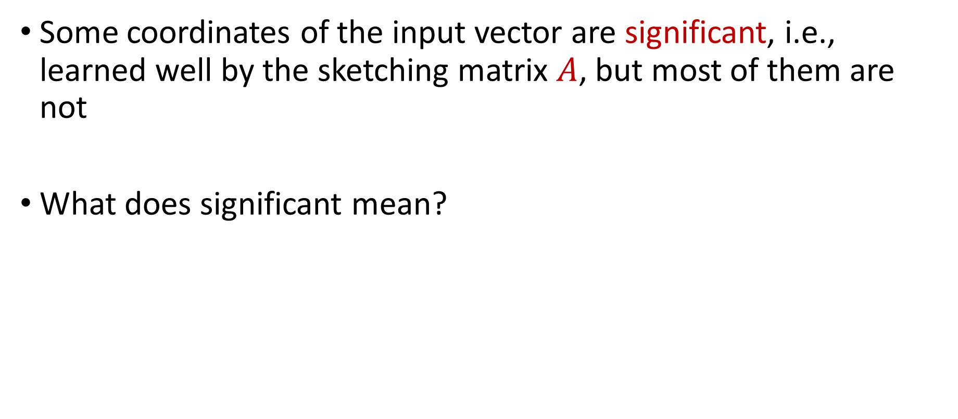
A Motivating Question
Some coordinates of the input vector are significant, i.e., learned well by the sketching matrix $A$, but most of them are not
What does significant mean?

Slide 25
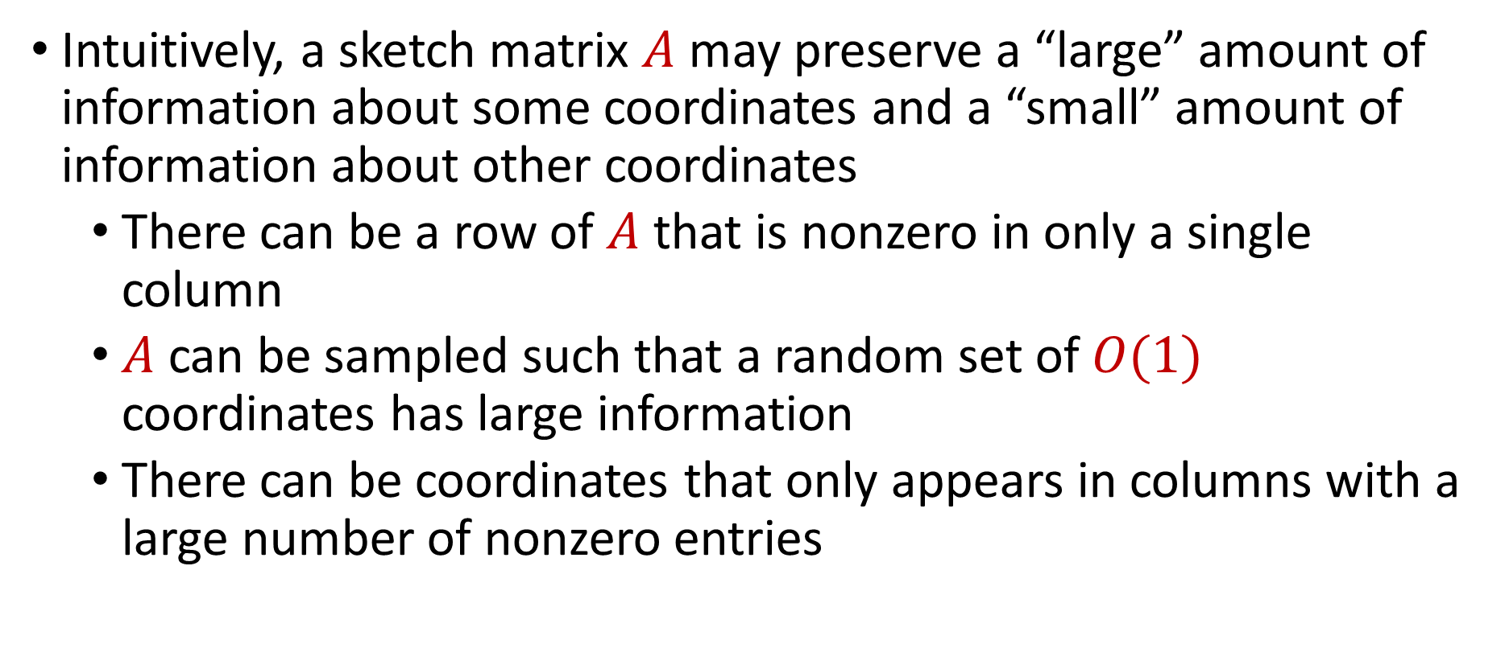
A Motivating Question
Intuitively, a sketch matrix $A$ may preserve a “large” amount of information about some coordinates and a “small” amount of information about other coordinates
There can be a row of $A$ that is nonzero in only a single column
$A$ can be sampled such that a random set of $O(1)$ coordinates has large information
There can be coordinates that only appears in columns with a large number of nonzero entries

Slide 26
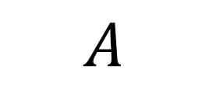
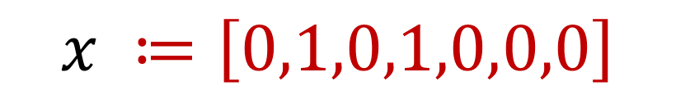
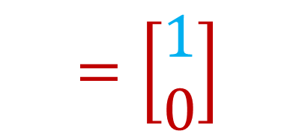
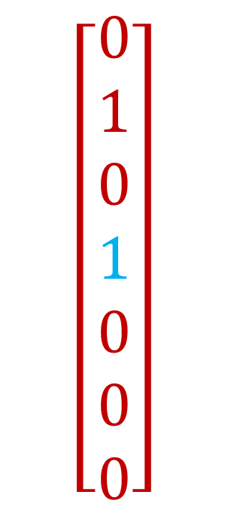
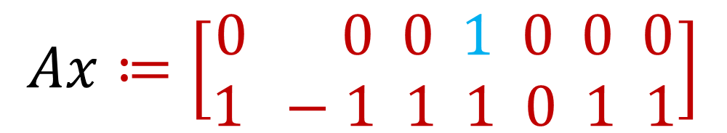
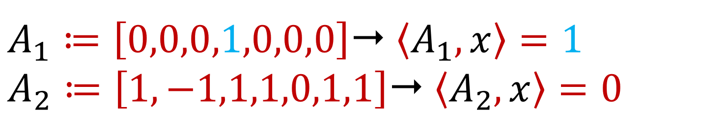
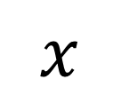
$$\left[\begin{aligned}0 \\ 1 \\ 0 \\ 1 \\ 0 \\ 0 \\ 0\end{aligned}\right]$$
$$A$$
$$Ax≔\left[\begin{aligned}0 0 0 1 0 0 0 \\ 1 −1 1 1 0 1 1\end{aligned}\right]$$
$$=\left[\begin{aligned}1 \\ 0\end{aligned}\right]$$
$$x$$
$$x ≔\left[0,1,0,1,0,0,0\right]$$
$A_{1}≔\left[0,0,0,1,0,0,0\right]$ $\left\langle A_{1},x\right\rangle =1$
$A_{2}≔\left[1,−1,1,1,0,1,1\right]$ $\left\langle A_{2},x\right\rangle =0$

Slide 27
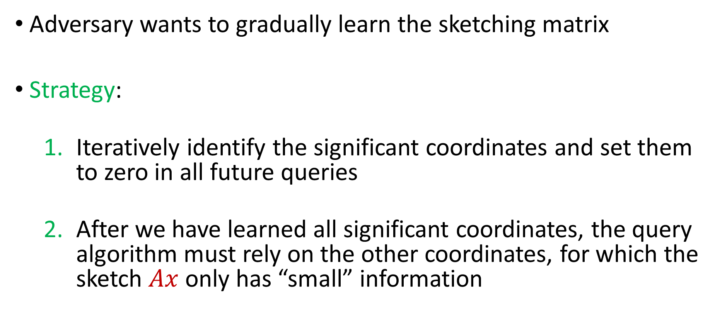
Attack Outline
Adversary wants to gradually learn the sketching matrix
Strategy:
Iteratively identify the significant coordinates and set them to zero in all future queries
After we have learned all significant coordinates, the query algorithm must rely on the other coordinates, for which the sketch $Ax$ only has “small” information

Slide 28
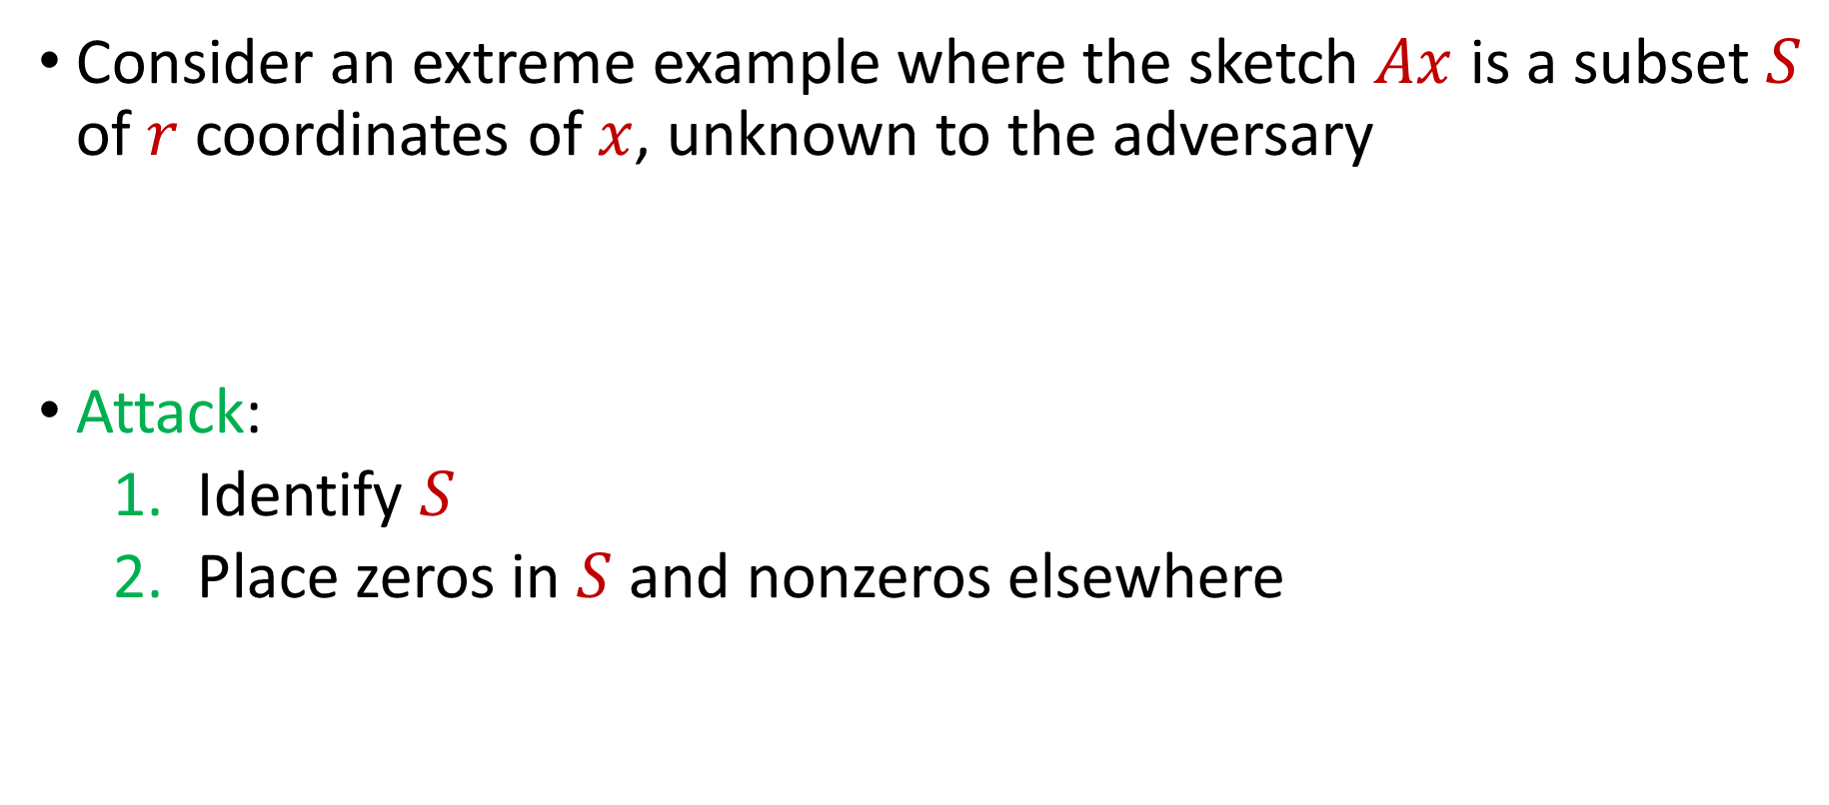
Attack Outline
Consider an extreme example where the sketch $Ax$ is a subset $S$ of $r$ coordinates of $x$, unknown to the adversary
Attack:
Identify $S$
Place zeros in $S$ and nonzeros elsewhere

Slide 29
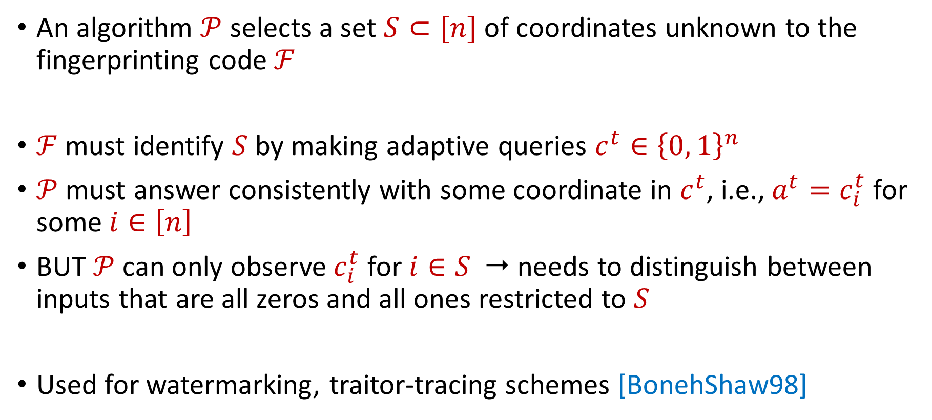
Interactive Fingerprinting Code Problem
An algorithm $𝒫$ selects a set $S⊂[n]$ of coordinates unknown to the fingerprinting code $ℱ$
$ℱ$ must identify $S$ by making adaptive queries $c^{t}∈{\left\{0, 1\right\}}^{n}$
$𝒫$ must answer consistently with some coordinate in $c^{t}$, i.e., $a^{t}=c_{i}^{t}$ for some $i∈\left[n\right]$
BUT $𝒫$ can only observe $c_{i}^{t}$ for $i∈S$  needs to distinguish between inputs that are all zeros and all ones restricted to $S$
Used for watermarking, traitor-tracing schemes [BonehShaw98]

Slide 30
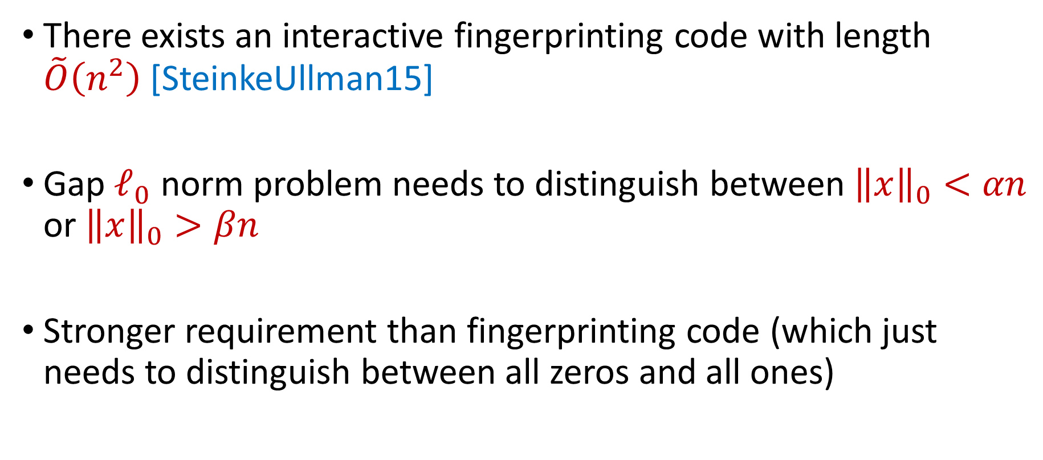
Interactive Fingerprinting Codes
There exists an interactive fingerprinting code with length $\tilde{O}\left(n^{2}\right)$ [SteinkeUllman15]
Gap $ℓ_{0}$ norm problem needs to distinguish between ${\left\|x\right\|}_{0}<αn$ or ${\left\|x\right\|}_{0}>βn$
Stronger requirement than fingerprinting code (which just needs to distinguish between all zeros and all ones)

Slide 31
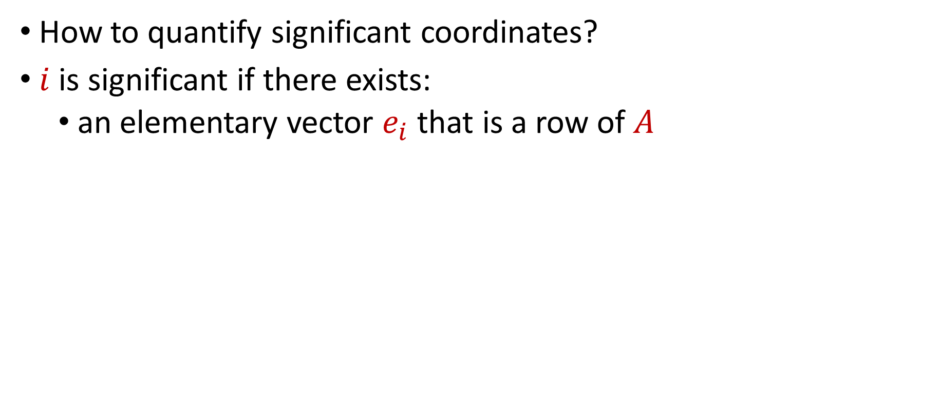
Significant Coordinates (I)
How to quantify significant coordinates?
$i$ is significant if there exists:
an elementary vector $e_{i}$ that is a row of $A$

Slide 32
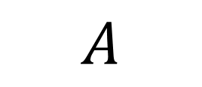
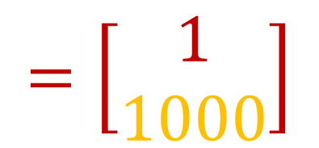
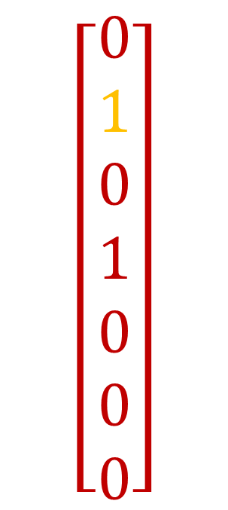
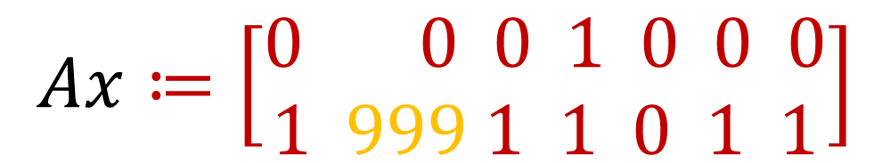
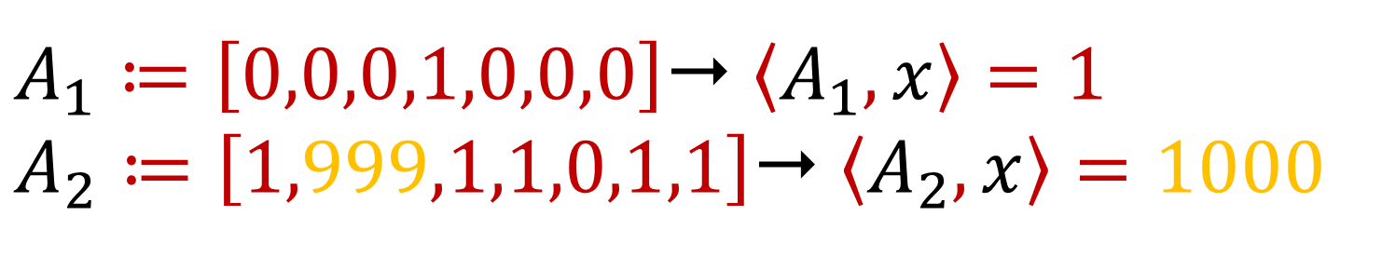
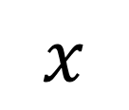
$$\left[\begin{aligned}0 \\ 1 \\ 0 \\ 1 \\ 0 \\ 0 \\ 0\end{aligned}\right]$$
$$A$$
$$Ax≔\left[\begin{aligned}0 0 0 1 0 0 0 \\ 1 999 1 1 0 1 1\end{aligned}\right]$$
$$=\left[\begin{aligned}1 \\ 1000\end{aligned}\right]$$
$$x$$
$$x ≔\left[0,1,0,1,0,0,0\right]$$
$A_{1}≔\left[0,0,0,1,0,0,0\right]$ $\left\langle A_{1},x\right\rangle =1$
$A_{2}≔\left[1,999,1,1,0,1,1\right]$ $\left\langle A_{2},x\right\rangle =1000$

Slide 33
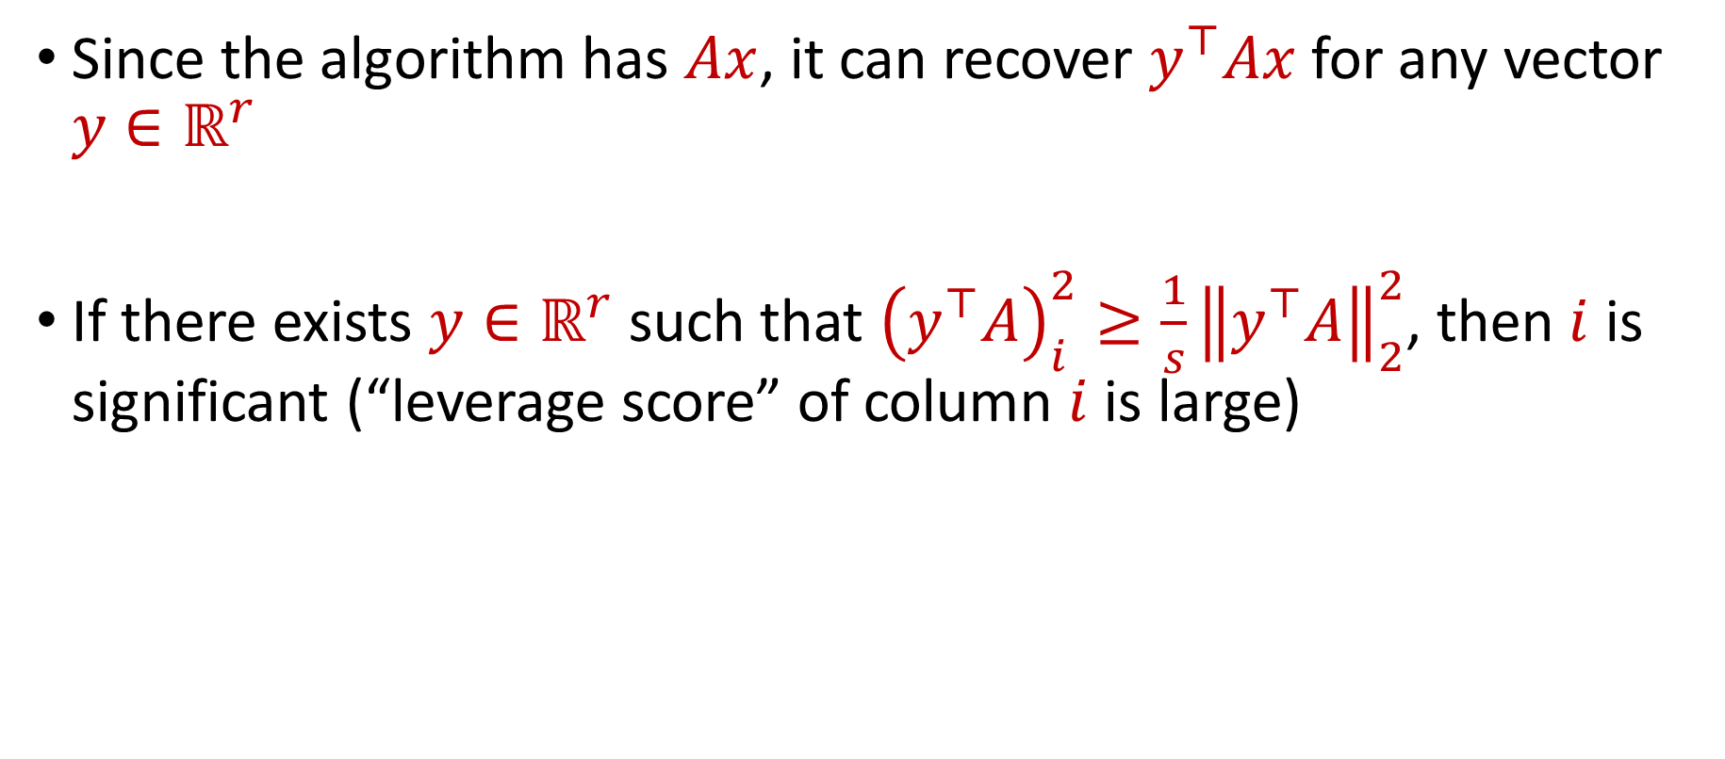
Significant Coordinates (II)
Since the algorithm has $Ax$, it can recover $y^{⊤}Ax$ for any vector $y∈ℝ^{r}$
If there exists $y∈ℝ^{r}$ such that ${\left(y^{⊤}A\right)}_{i}^{2}≥\frac{1}{s}{\left\|y^{⊤}A\right\|}_{2}^{2}$, then $i$ is significant (“leverage score” of column $i$ is large)

Slide 34
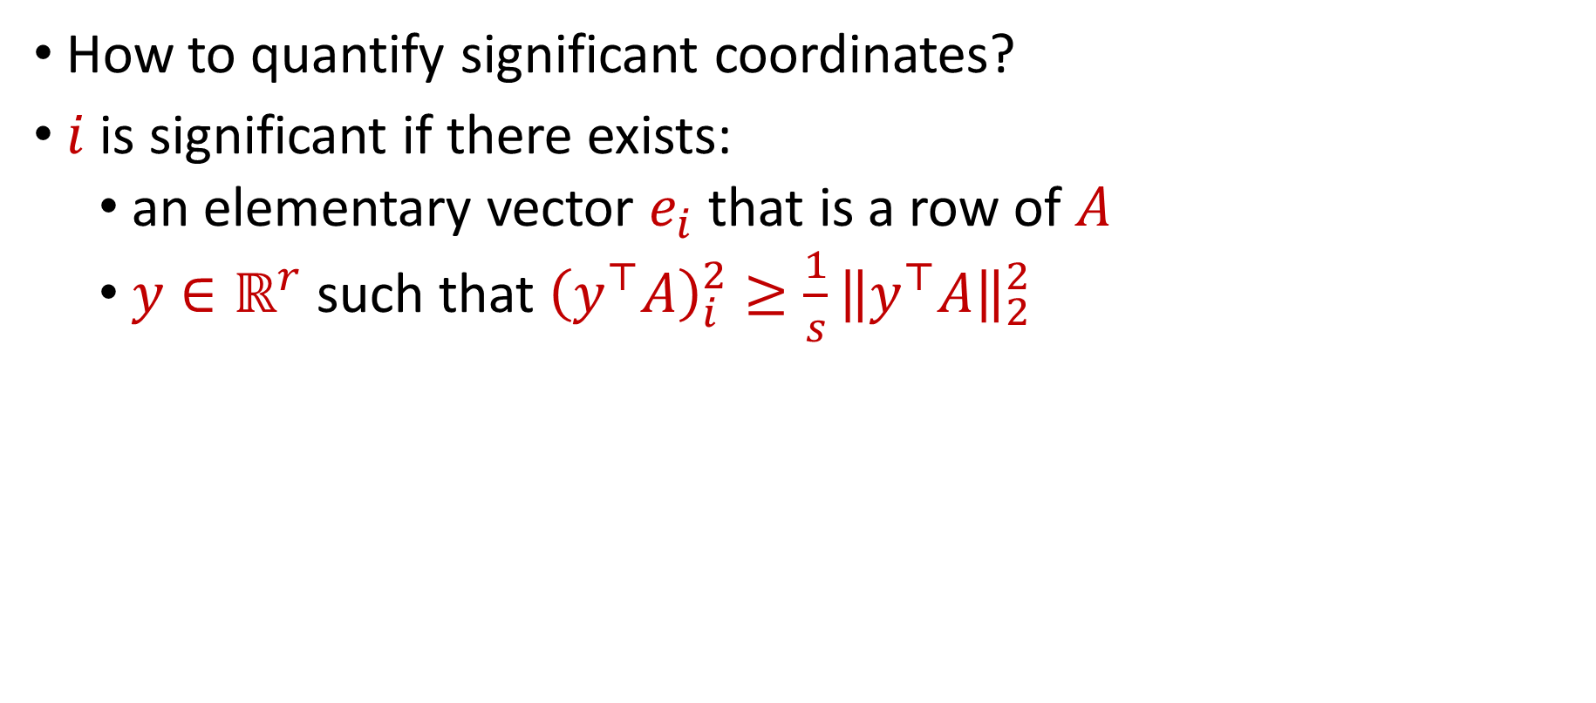
Significant Coordinates (II)
How to quantify significant coordinates?
$i$ is significant if there exists:
an elementary vector $e_{i}$ that is a row of $A$
$y∈ℝ^{r}$ such that ${\left(y^{⊤}A\right)}_{i}^{2}≥\frac{1}{s}{\left\|y^{⊤}A\right\|}_{2}^{2}$

Slide 35
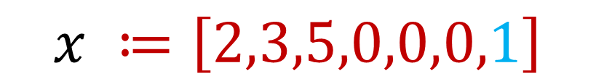

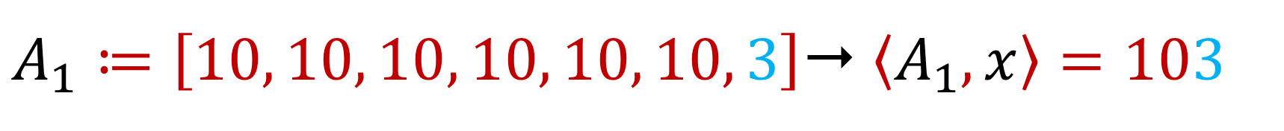
$A_{1}≔\left[10, 10, 10, 10, 10, 10, 3\right]$ $\left\langle A_{1},x\right\rangle =103$
$$x ≔\left[2,3,5,0,0,0,1\right]$$
Reveals information about $x_{n}$ modulo $10$

Slide 36

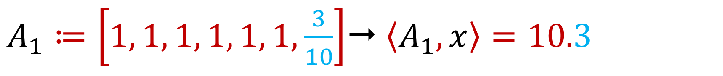
$A_{1}≔\left[1, 1, 1, 1, 1, 1,\frac{3}{10}\right]$ $\left\langle A_{1},x\right\rangle =10.3$
$$x ≔\left[2,3,5,0,0,0,1\right]$$
**Fractional** part of ${\left(y^{⊤}A\right)}_{n}$ is large, for $y$ selecting the first row of $A$

Slide 37
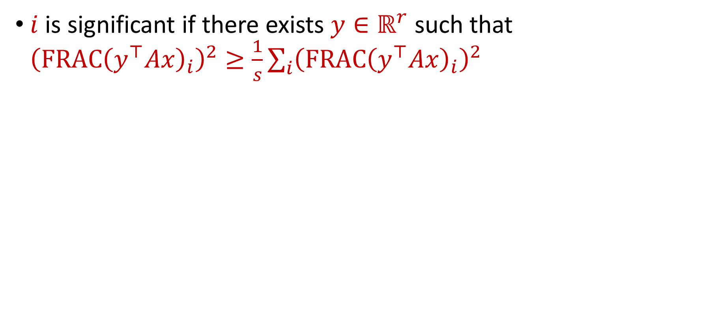
Significant Coordinates (III)
$i$ is significant if there exists $y∈ℝ^{r}$ such that ${\left(FRAC{\left(y^{⊤}Ax\right)}_{i}\right)}^{2}≥\frac{1}{s}\sum_{i}{{\left(FRAC{\left(y^{⊤}Ax\right)}_{i}\right)}^{2}}$

Slide 38
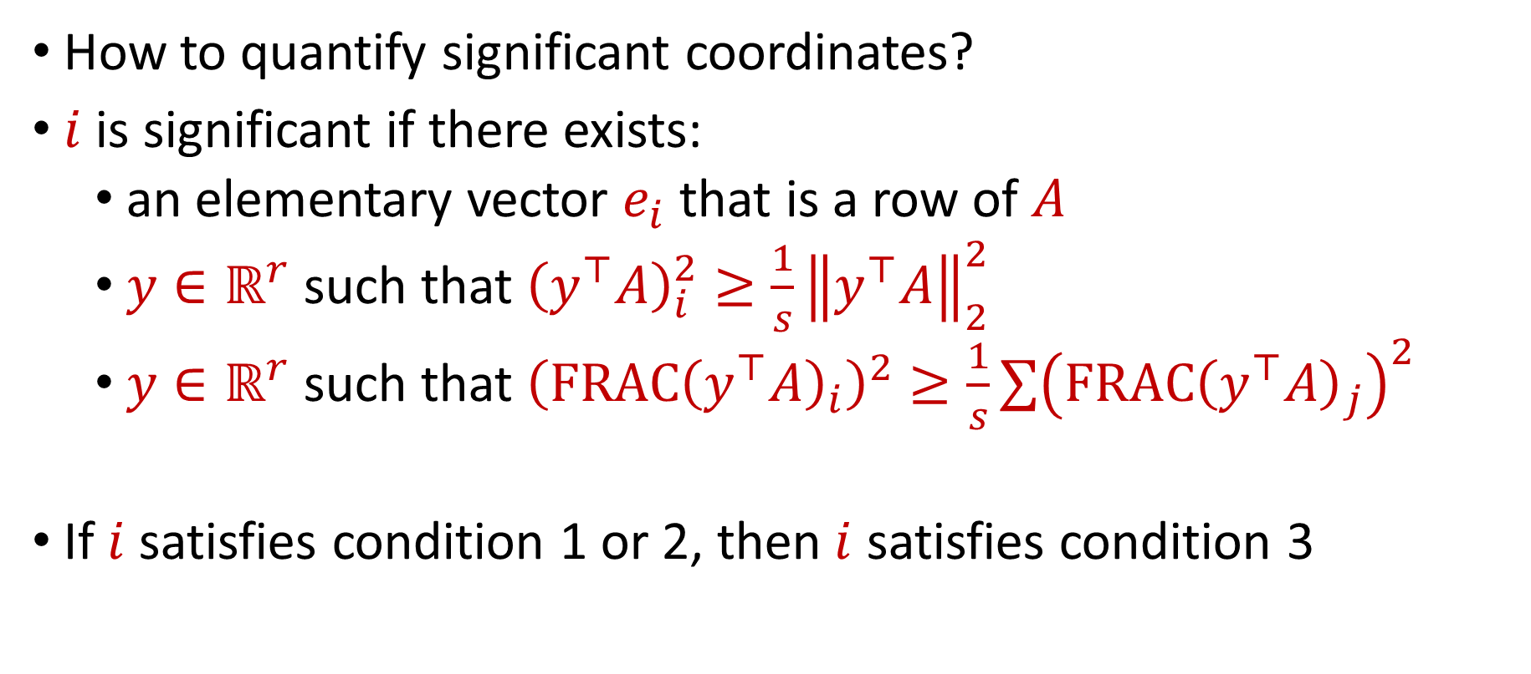
Significant Coordinates
How to quantify significant coordinates?
$i$ is significant if there exists:
an elementary vector $e_{i}$ that is a row of $A$
$y∈ℝ^{r}$ such that ${\left(y^{⊤}A\right)}_{i}^{2}≥\frac{1}{s}{\left\|y^{⊤}A\right\|}_{2}^{2}$
$y∈ℝ^{r}$ such that ${\left(FRAC{\left(y^{⊤}A\right)}_{i}\right)}^{2}≥\frac{1}{s}\sum{{\left(FRAC{\left(y^{⊤}A\right)}_{j}\right)}^{2}}$
If $i$ satisfies condition 1 or 2, then $i$ satisfies condition 3

Slide 39
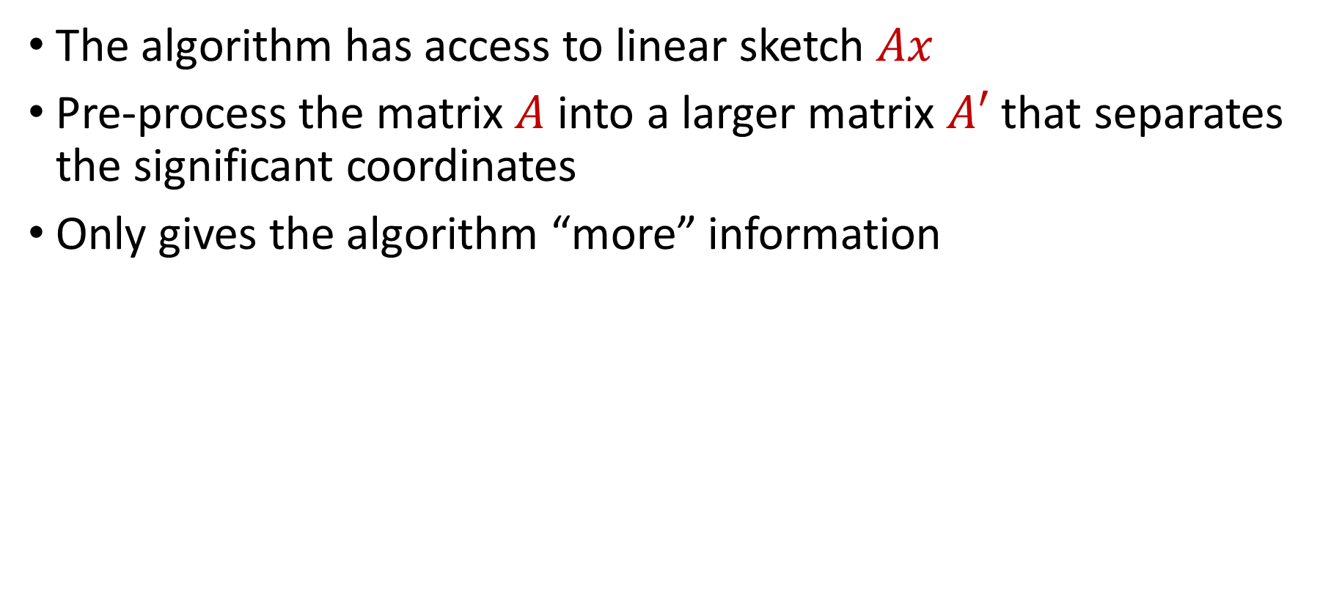


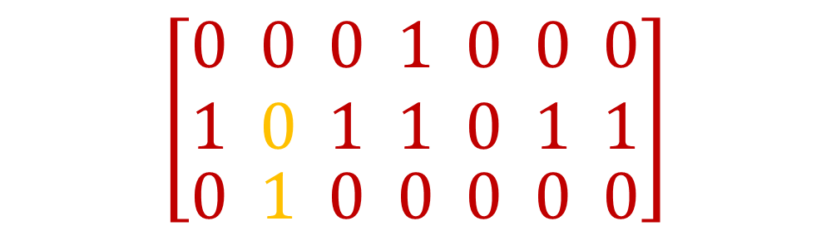
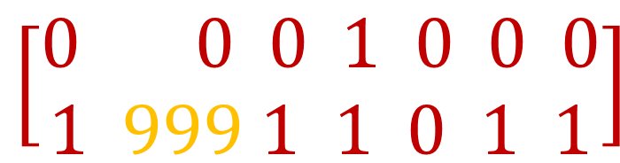
Pre-processing the Sketch Matrix
The algorithm has access to linear sketch $Ax$
Pre-process the matrix $A$ into a larger matrix $A′$ that separates the significant coordinates
Only gives the algorithm “more” information
$$\left[\begin{aligned}\begin{aligned}0 0 0 1 0 0 0 \\ 1 0 1 1 0 1 1\end{aligned} \\ 0 1 0 0 0 0 0\end{aligned}\right]$$
$$\left[\begin{aligned}0 0 0 1 0 0 0 \\ 1 999 1 1 0 1 1\end{aligned}\right]$$
$$A$$
$$A′$$

Slide 40
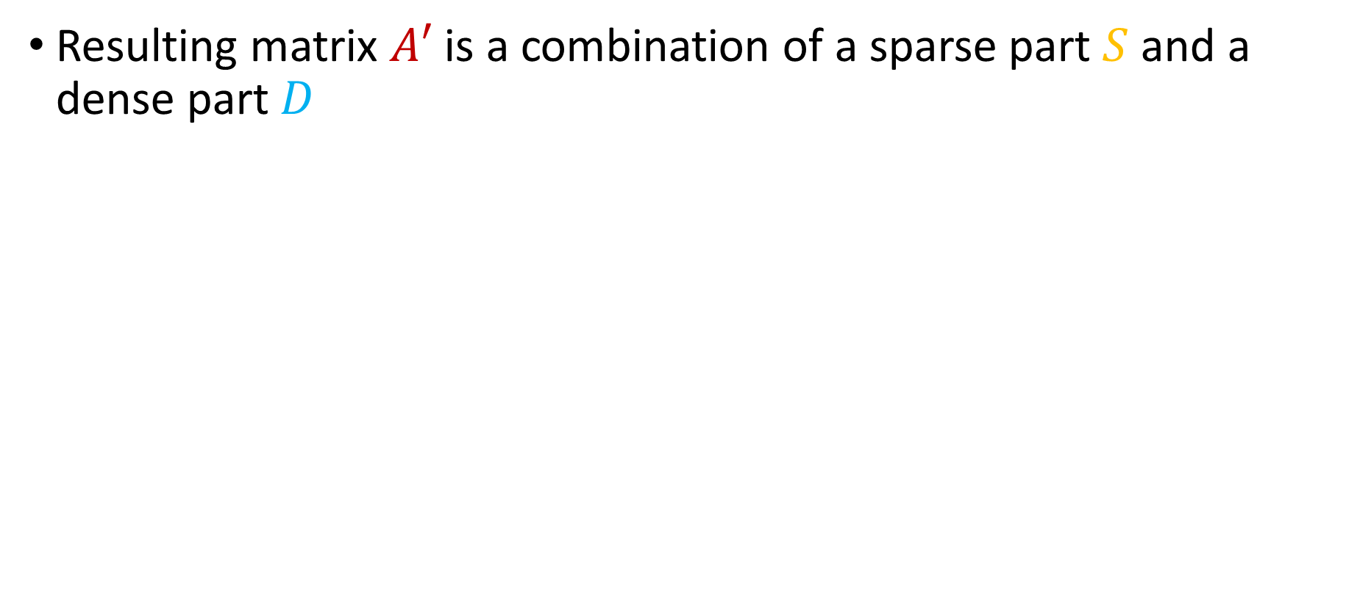
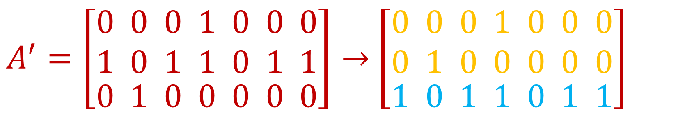

Pre-processing the Sketch Matrix
Resulting matrix $A′$ is a combination of a sparse part $S$ and a dense part $D$
$$A^{′}=\left[\begin{aligned}S \\ D\end{aligned}\right]$$
$A^{′}=\left[\begin{aligned}\begin{aligned}0 0 0 1 0 0 0 \\ 1 0 1 1 0 1 1\end{aligned} \\ 0 1 0 0 0 0 0\end{aligned}\right]→$ $\left[\begin{aligned}\begin{aligned}0 0 0 1 0 0 0 \\ 0 1 0 0 0 0 0\end{aligned} \\ 1 0 1 1 0 1 1\end{aligned}\right]$

Slide 41


Pre-processing the Sketch Matrix
Sparse part $S$ has at most one nonzero entry per column
Dense part $D$ has no significant columns
Show only $O(rs\log{n})$ rows added to $A$
Note that if there were no dense part, we can use fingerprinting code to attack $S$
$$\left[\begin{aligned}\begin{aligned}0 0 0 1 0 0 0 \\ 0 1 0 0 0 0 0\end{aligned} \\ 1 0 1 1 0 1 1\end{aligned}\right]$$

Slide 42

Pre-processing the Sketch Matrix
Sparse part $S$ has at most one nonzero entry per column
Dense part $D$ has no significant columns
Show only $O(rs\log{n})$ rows added to $A$
Note that if there were no dense part, we can use fingerprinting code to attack $S$
$$\left[\begin{aligned}\begin{aligned}0 0 0 1 0 0 0 \\ 0 1 0 0 0 0 0\end{aligned} \\ 1 0 1 1 0 1 1\end{aligned}\right]$$
If we subsample coordinates of a random input ${x∈\left\{−1,1\right\}}^{n}$ at rate $\frac{1}{s}$ and repeat independently $s\log{n}$ times, obtaining sketches $Ax^{1},…, Ax^{s\log{n}}$, we can recover any significant coordinate by looking at fractional parts of $L_{2}$ norm. But $O\left(rs\log{n}\right)$ bits of information in $Ax^{1},…, Ax^{s\log{n}}$

Slide 43

Overall Attack
Pre-process the matrix $A$ into a matrix $A′$ that is a combination of a sparse part $S$ and a dense part $D$
Attack sparse part $S$ using fingerprinting code
Attack dense part $D$

Slide 44
Questions?
Upcoming
Attack on dense part

Slide 45

Attacking the Dense Part
Design a family of distributions $𝒟$ over $\left[−R,…,−1,0,1,…,R\right]$ with $R=poly(r s\log{n)}$ such that:
For $D_{p}∈𝒟$ with $p∈\left[α,β\right]$, we have $\underset{X∼D_{p}}{Pr}\left[X=0\right]=p$
For any $q,p∈\left[α,β\right]\text{,}$ the total variation distance between $Dx_{p}$ and $Dx_{q}$ is small, i.e., $\frac{1}{poly(n)}$
We show these are the only distributions needed for the fingerprinting code – dense part does not help for these!

Slide 46

Attacking the Dense Part
Design a family of distributions $𝒟$ over $\left[−R,…,−1,0,1,…,R\right]$ with $R=poly(r s\log{n)}$ such that:
For $D_{p}∈𝒟$ with $p∈\left[α,β\right]$, we have $\underset{X∼D_{p}}{Pr}\left[X=0\right]=p$
For any $q,p∈\left[α,β\right]\text{,}$ the total variation distance between $Dx_{p}$ and $Dx_{q}$ is small, i.e., $\frac{1}{poly(n)}$
If $x∼D_{p}^{n}$, then $Ex\left[{\left\|x\right\|}_{0}\right]=pn$ and if $x∼D_{q}^{n}$, then $Ex\left[{\left\|x\right\|}_{0}\right]=qn$, but the marginal distribution of $Dx$ is nearly identical for $x∼D_{p}^{n}$ and $x∼D_{q}^{n}$, so the algorithm must use $Sx$

Slide 47

Overall Attack
Pre-process the matrix $A$ into a matrix $A′$ that is a combination of a sparse part $S$ and a dense part $D$
Attack sparse part $S$ using fingerprinting code
Attack dense part $D$ using the family of distributions $𝒟$

Slide 48



Bounding the Total Variation Distance
Let $P$ be the probability distribution corresponding to $Dx_{p}$ and $Q$ be the probability distribution corresponding to $Dx_{q}$
To bound the total variation distance between $P$ and $Q$, we multiply the support size ($n^{O(rs\log{n})})$ of P and Q by a pointwise bound:
$$\left|P\left(x\right)−Q\left(x\right)\right|=\left|\frac{1}{{\left(2π\right)}^{r}}\int_{u∈{\left[−π, π\right]}^{r}}{e^{i\left\langle u,x\right\rangle }}\left(\hat{P}\left(u\right)−\hat{Q}\left(u\right)\right)du\right|$$
$≤\frac{1}{{\left(2π\right)}^{r}}$ $\int_{u∈{\left[−π, π\right]}^{r}}{\left|\hat{P}\left(u\right)−\hat{Q}\left(u\right)\right| du}$

Slide 49



Bounding the Total Variation Distance
For a symmetric product distribution, we can write
$$\hat{P}\left(u\right)=E_{z∼P}\left[e^{−i⟨u,z⟩}\right]$$
$$=\prod_{j∈[n]}{\sum_{k≥0}{\left(M_{p}(2k)\right)}⋅f(D^{j},u,k)}$$
where $M_{p}\left(2k\right)=\left(\sum_{m≥0}{P_{m}m^{2k}}\right)$ is the $2k$-th moment of the distribution and $f$ is a rapidly decaying function independent of $P$
Expand $e^{−i⟨u,z⟩}$ into cosines and this is where fractional parts arise – use preprocessing to bound these fractional parts!

Slide 50


Bounding the Total Variation Distance
To analyze the total variation distance, we have
$$\left|\hat{P}\left(u\right)−\hat{Q}\left(u\right)\right|=\prod_{j∈[n]}{\sum_{k≥0}{\left(M_{p}\left(2k\right)−M_{q}(2k)\right)}⋅f(D^{j},u,k)}$$
so if the moments of the distributions of $P$ and $Q$ match, up to a sufficiently large $k$, this helps TVD be small!

Slide 51

Constructing Hard Distributions
Design a family of distributions $𝒟$ over $\left[−R,…,−1,0,1,…,R\right]$ with $R=poly(r s\log{n })$ such that:
For $D_{p}∈𝒟$ with $p∈\left[a,b\right]$, we have $\underset{X∼D_{p}}{Pr}\left[X=0\right]=p$
For any $q,p∈\left[a,b\right]$, the total variation distance between $Dx_{p}$ and $Dx_{q}$ is small, i.e., $\frac{1}{poly(n)}$
Moments of the distributions of $D_{p}$and $D_{q}$ match

Slide 52


Moment Matching
Want $E_{X∼D_{p}}\left[X^{k}\right]=E_{X∼D_{q}}\left[X^{k}\right]$ for all $k≤K=O(r\log{n})$
[LarsenWeinsteinYu20, Sherstov] There is a degree $R$ polynomial $Q$ such that for all $t<R^{1/2}$ and constant $ε:$
$$\left|Q\left(0\right)\right|>ε$$
Allows creating distributions with
large probability at 0
$$\sum_{i=0}^{R}{{\left(−1\right)}^{i}\left({R \atop i}\right)⋅Q\left(i\right)⋅i^{t}}=0$$
Allows creating distributions with
first t matching moments

Slide 53




Moment Matching
Want ${Ex}_{X∼D_{p}}\left[X^{k}\right]={Ex}_{X∼D_{q}}\left[X^{k}\right]$ for all $k≤K=O(r\log{n})$
There exists [LarsenWeinsteinYu20] a polynomial $Q$ such that $\left|Q\left(0\right)\right|=Ω\left(1\right)$ and for all $t<R−\deg\left(Q\right):$
$$\sum_{i=0}^{R}{\left|\left({R \atop i}\right)⋅Q\left(i\right)\right|}=O\left(1\right)$$
Set $D_{p}\left(i\right)$ to be
$D\left(i\right)+c_{p}⋅{\left(−1\right)}^{i}$ ${\left(−1\right)}^{i}\left({R \atop i}\right)⋅Q\left(i\right)⋅i^{t}$
$$\sum_{i=0}^{R}{{\left(−1\right)}^{i}\left({R \atop i}\right)⋅Q\left(i\right)⋅i^{t}}=0$$

Slide 54
Overall Attack
Pre-process the matrix $A$ into a matrix $A′$ that is a combination of a sparse part $S$ and a dense part $D$
Attack sparse part $S$ using fingerprinting code
Attack dense part $D$ using the family of distributions $𝒟$

Slide 55

Main Result
There is a constant $ε=Ω\left(1\right)$ so that any linear sketch giving a $(1+ε)$-approximation to $ℓ_{0}$ on an adversarial insertion-deletion stream using $r< n^{c}$ rows, for a constant $c>0$, can be broken in $\tilde{O}\left(r^{8}\right)$ queries

Slide 56

Main Results
There exists a constant $ε=Ω\left(1\right)$ such that any linear sketch that produces $(1+ε)$-approximation to $ℓ_{0}$ on an adversarial insertion-deletion stream on universe $n$ requires $poly(n)$ rows
There exists a constant $ε=Ω\left(1\right)$ such that any linear skech that produces $(1+ε)$-approximation to $ℓ_{0}$ on an adversarial insertion-deletion stream using $r≪n$ rows can be broken in $\tilde{O}\left(r^{8}\right)$ queries.

Slide 57

Additional Results
Any linear skech that produces $1.1$-approximation to $ℓ_{0}$ on an adversarial insertion-deletion stream using $r≪n$ rows can be broken in $\tilde{O}\left(r^{3}\right)$ queries, if the calculations are performed on finite fields $𝔽_{p}$
There exists an attack on any real-valued linear sketch with “bounded subdeterminants” that produces $O(1)$-approximation to $ℓ_{0}$ on an adversarial insertion-deletion stream with $r≪n$ rows, using $poly\left(r\right)$ queries

Slide 58
Future Directions
Attacks with a smaller number of queries?
Attacks against pseudo-deterministic algorithms?

Slide 59





Future Directions
Attacks on linear-sketches for $ℓ_{0}$ estimation on adversarial insertion-deletion streams
Attacks on streaming algorithms for $ℓ_{0}$ estimation on adversarial insertion-deletion streams
Attacks on linear-sketches for $ℓ_{p}$ estimation on adversarial insertion-deletion streams
Attacks on streaming algorithms for $ℓ_{p}$ estimation on adversarial insertion-deletion streams

